Slide 1
Issues
1. States of Denial
2. The Present Condition
3. The Status and Reception of Climate Refugees
4. Can Climate Change be Addressed Democratically?
5. The Balance Between Adaptation and Mitigation
6. Behaviour Shifts

Slide 2
1. States of Denial
Knowing and Not Knowing: The Arendt – Cohen thesis
1a Hannah Arendt, Eichmann in Jerusalem
1b Stanley Cohen, States of Denial
Paralysed in the Headlights: The Pavlovian thesis
3. The Disfunctionality of “Crisis” Language

Slide 3
2. The Present Condition

Slide 4
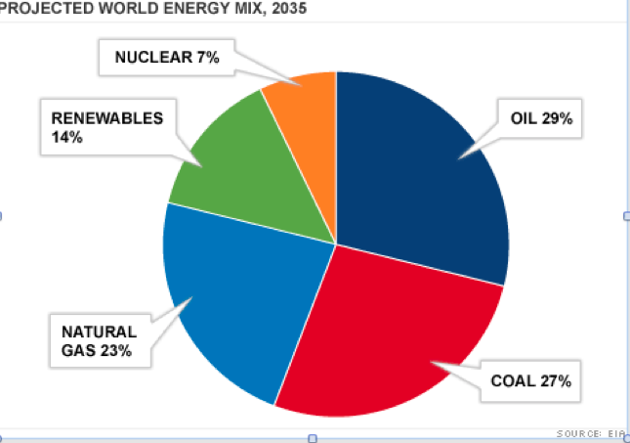

Slide 5
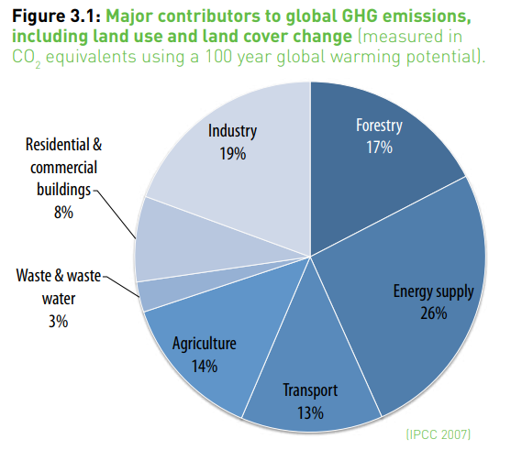
Source: United Nations Environmental Programme
Notes:
http://www.unep.fr/shared/publications/pdf/dtix1262xpa-priorityproductsandmaterials_report.pdf

Slide 6
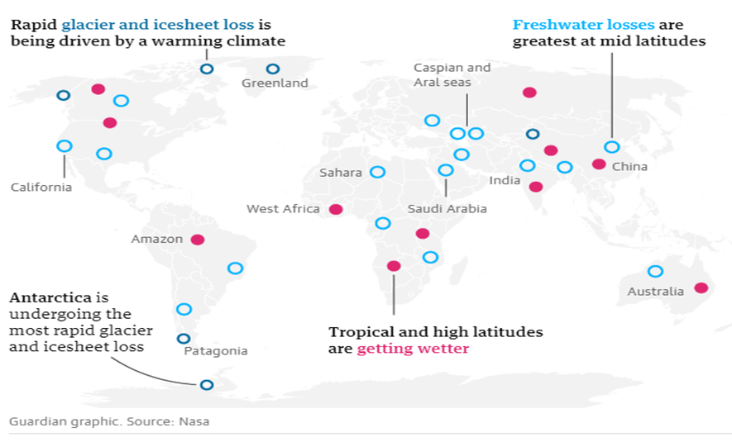
30 hotspots where freshwater is in danger

Slide 7
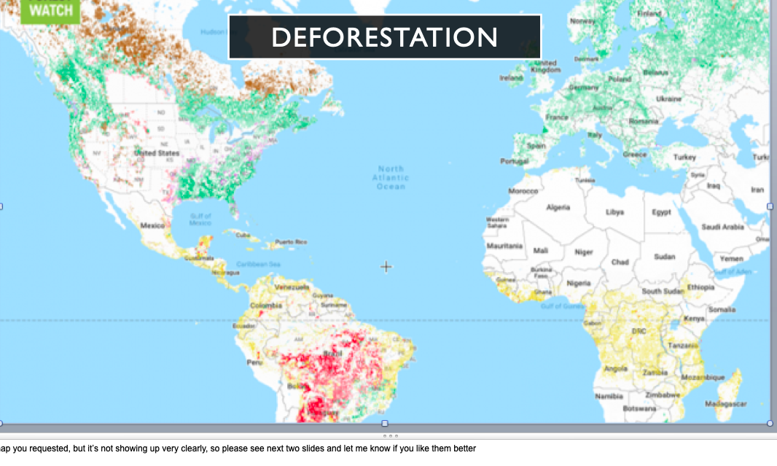

Slide 8
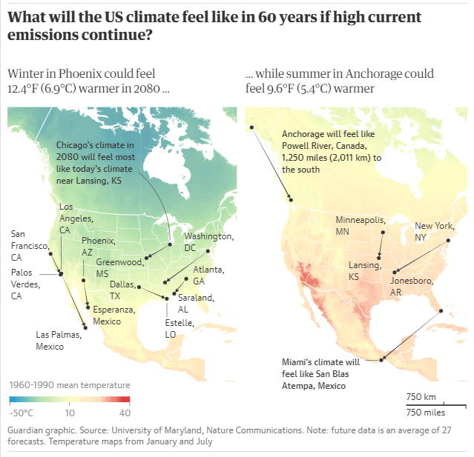

Slide 9
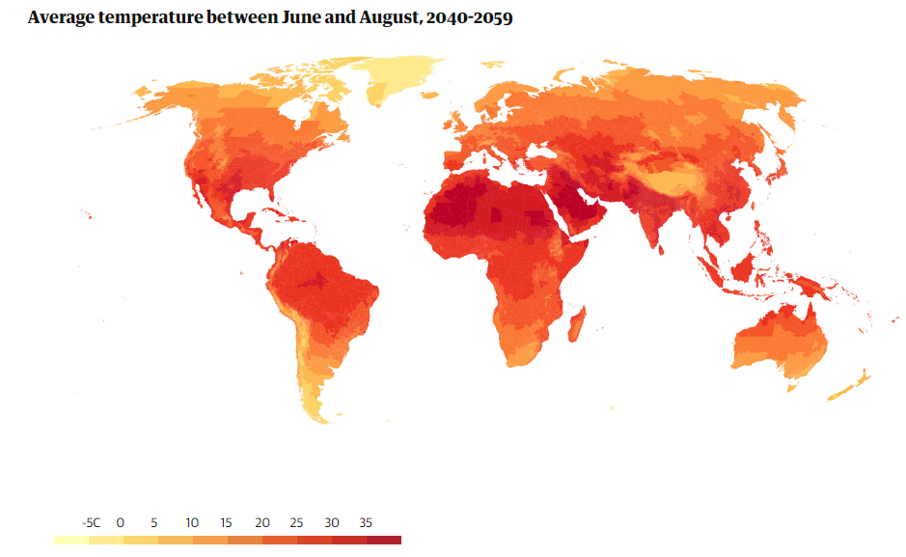
Notes:
https://www.theguardian.com/cities/ng-interactive/2018/aug/14/which-cities-are-liveable-without-air-conditioning-and-for-how-much-longer

Slide 10
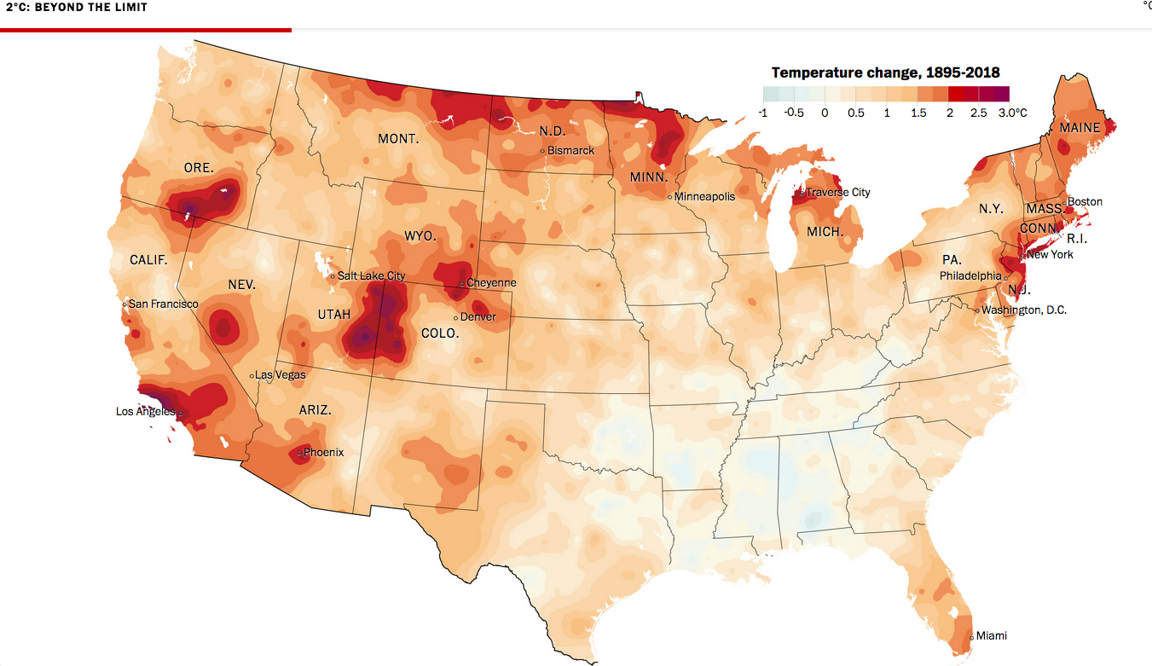
Path dependent irregularities (1) – Hot Spots
Notes:
https://www.washingtonpost.com/graphics/2019/national/climate-environment/climate-change-america/

Slide 11
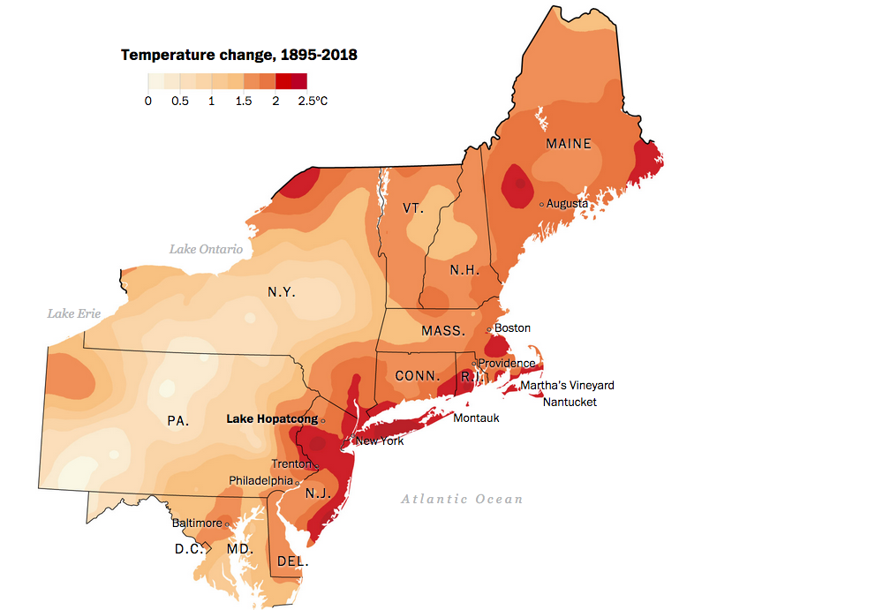
Path dependent irregularities (2)
Notes:
hot spots northeast coast
https://www.washingtonpost.com/graphics/2019/national/climate-environment/climate-change-america/

Slide 12
A particularly urban danger: flooding

Slide 13
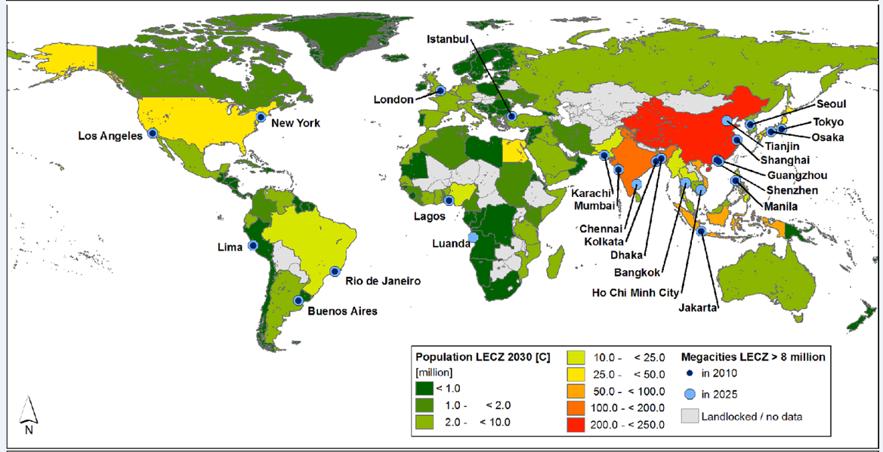
Population growth by 2030: Coastal Cities
Notes:
Neumann B, Vafeidis AT, Zimmermann J, Nicholls RJ (2015) Future Coastal Population Growth and Exposure to Sea-Level Rise and Coastal Flooding - A Global Assessment. PLOS ONE 10(3): e0118571. https://doi.org/10.1371/journal.pone.0118571
https://journals.plos.org/plosone/article?id=10.1371/journal.pone.0118571
The results show significant increases in coastal population living in the LECZ and of people being potentially exposed to coastal flood events. They highlight regions that will most likely experience rapid increases in exposure, such as Africa, and depict that Asia is the continent that has had the largest number of total and of urban population in the LECZ and the 100-year flood plain in the year 2000 and will continue to do so in the future. Our results emphasise that less developed countries are more exposed to flooding than more developed regions. Africa and Asia are expected to become increasingly exposed to sea-level rise and coastal hazards and thereby many countries that already now experience high vulnerability to such hazards. The five Asian countries China, India, Bangladesh, Indonesia and Viet Nam accounted for more than half of the global LECZ population in the year 2000 and will continue to do so under future scenarios, despite the rapid coastal growth of several African coastal nations. Further, our study suggests that densely-populated urban areas are less prevalent in the LECZ than expected, as our baseline assessment produced a significantly smaller urban population than previous studies. We need to stress, however, that earlier studies relate ‘urban’ areas to urban agglomerations that encompass densely populated urban areas and suburban and even peri-urban areas population. This is a topic for further investigation.

Slide 14
Flood map (UK): Projection 2050
20320
Notes:
https://friendsoftheearth.uk/climate-change/flood-map-england-and-wales-areas-risk-flooding

Slide 15
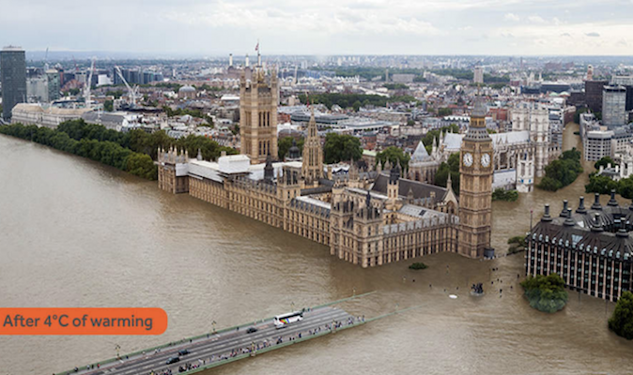
Notes:
https://news.sky.com/story/sinking-london-and-other-cities-face-flooding-due-to-rising-sea-levels-report-warns-11517220

Slide 16
3. The Status and Reception of Climate Refugees
Desertification and refugees to cities
Reformulation of refugee – migrant distinction

Slide 17
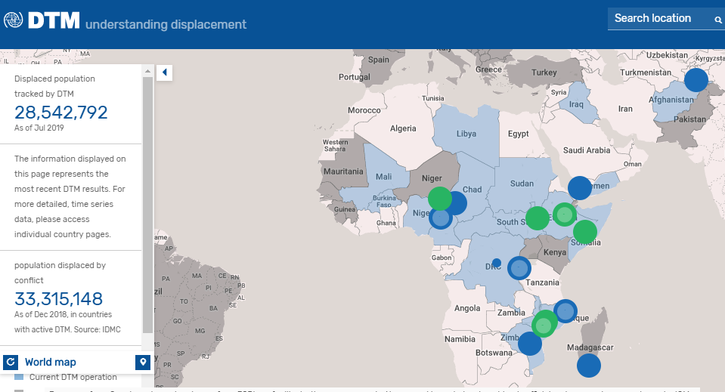
Displacement by natural hazards
Notes:
Map source: https://displacement.iom.int/
Out of the 17.7 million IDPs tracked by the IOM Displacement Tracking Matrix (IOM DTM),20 over 2 million people were displaced due to disasters linked to weather and climate events as at September 2018.21 Drought, floods and storms (including hurricanes and cyclones) were the events that led to the greatest number of disaster-induced displacement in 2018.
(WMO Climate report)

Slide 18
Desertification and urban migration

Slide 19
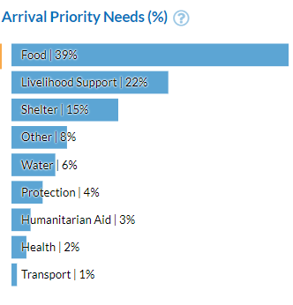
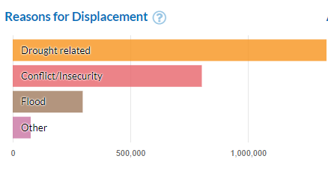
Displacement: Somalia
Notes:
https://unhcr.github.io/dataviz-somalia-prmn/index.html#reason=&month=2018-01-01%2C2018-07-31&pregio

Slide 20
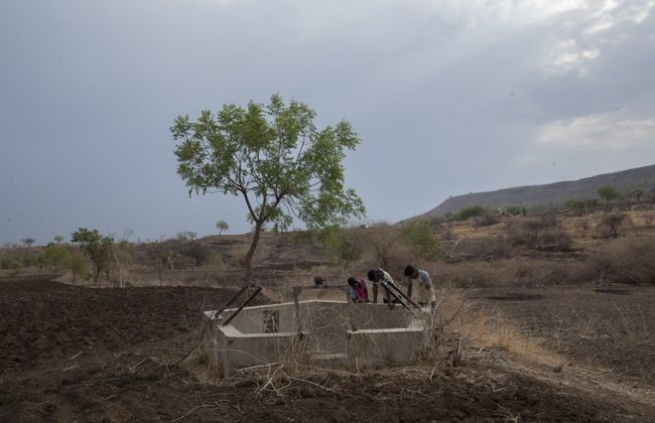
A dry well in Somalia (1)
Notes:
https://www.bbc.com/news/world-asia-india-48552199
Drought in India's western state of Maharashtra

Slide 21
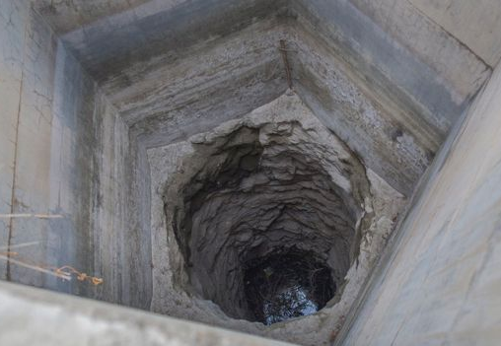
A dry well in Somalia (2)
Notes:
Hatkarwadi has 35 wells, most of which are dry.
https://www.bbc.com/news/world-asia-india-48552199

Slide 22
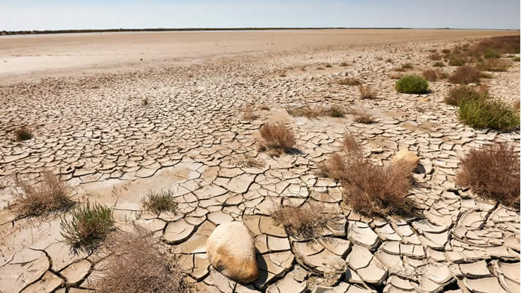
Notes:
Desertification. https://greentumble.com/causes-and-effects-of-desertification/

Slide 23
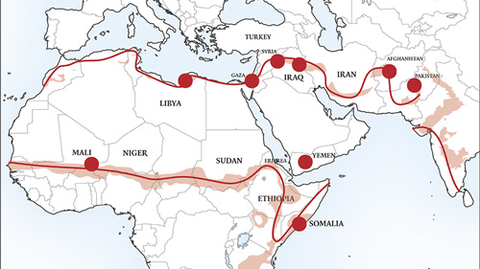
The ring of desertification. Red dots represent population centers affected by desertification
Notes:
http://clivethompson.net/2016/05/31/the-conflict-shoreline-a-map-that-correlates-climate-change-to-drone-strikes/

Slide 24
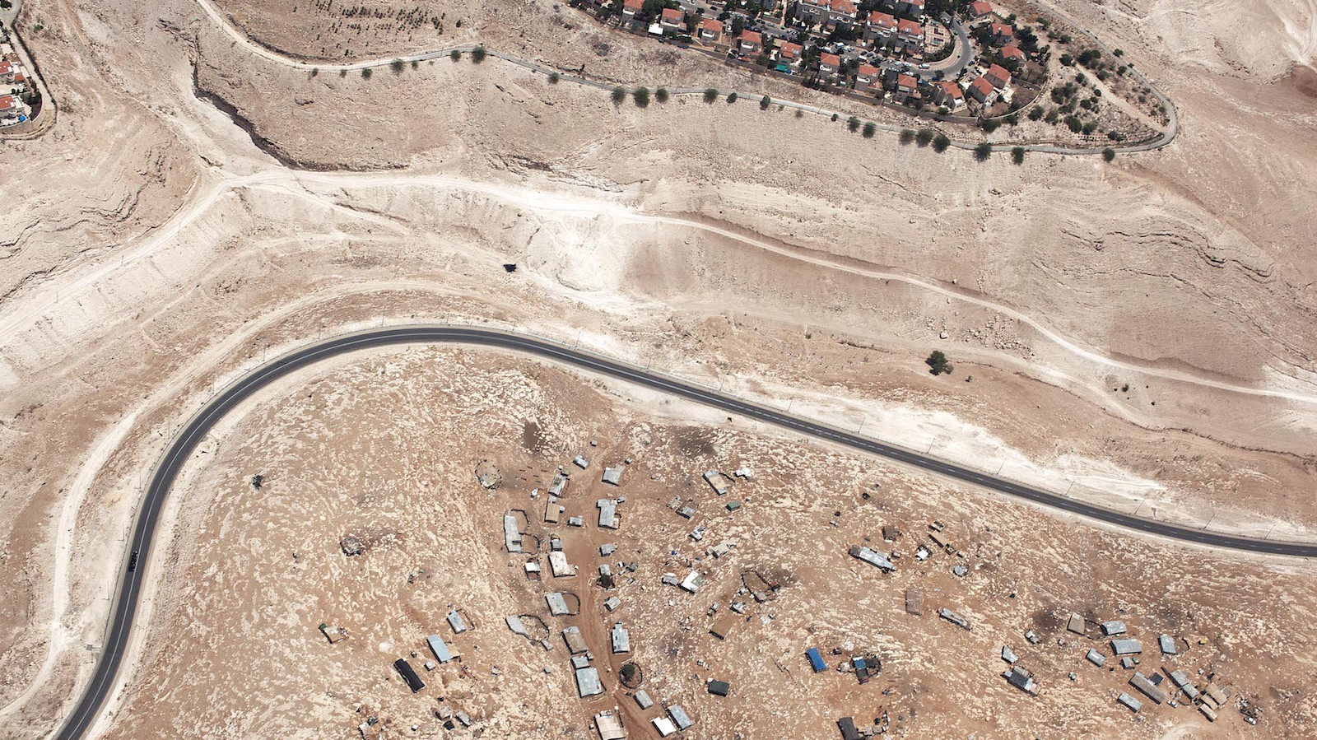
Desertification and the Israeli security fence
Notes:
Ma'ale Adumim and the Bedouin settlement of the Jahalin Tribe
http://www.uncubemagazine.com/blog/15969737

Slide 25
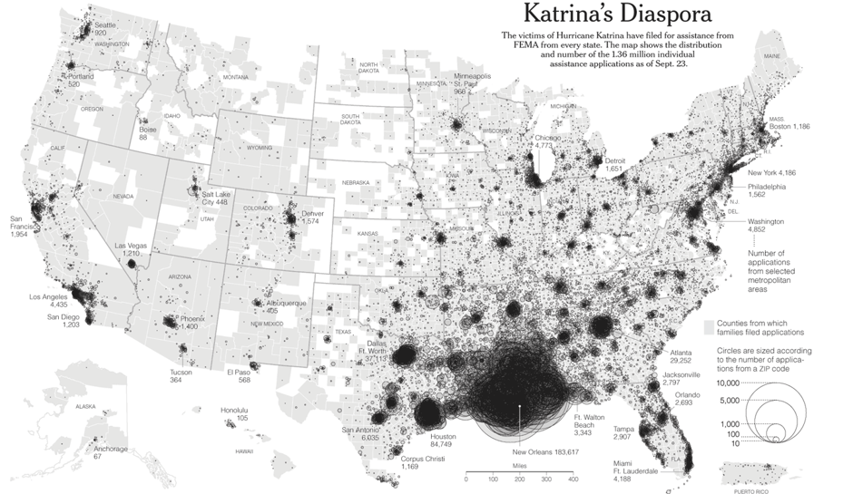
Notes:
https://www.citylab.com/equity/2015/08/10-years-later-theres-still-a-lot-we-dont-know-about-where-katrina-survivors-ended-up/401216/

Slide 26
4. Can Climate Change be Addressed Democratically?
The question of time
The question of scale

Slide 27
5. Mitigation and Adaptation

Slide 28
B.I.G.-designed Berm Proposal

Slide 29
BERM PROPOSAL

Slide 30
Mitigation, time, and the question of scale

Slide 31
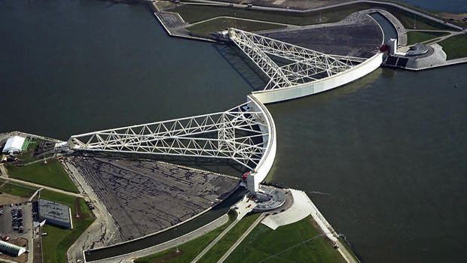
Mitigation: storm surge barrier, Rotterdam (1) – 45 year framework
Notes:
A massive storm surge barrier called the Maeslantkering, or Maeslant Barrier, was completed in 1997 to protect Rotterdam, Europe's largest port.
https://www.cbsnews.com/news/sea-change-how-the-dutch-confront-the-rise-of-the-oceans/

Slide 32
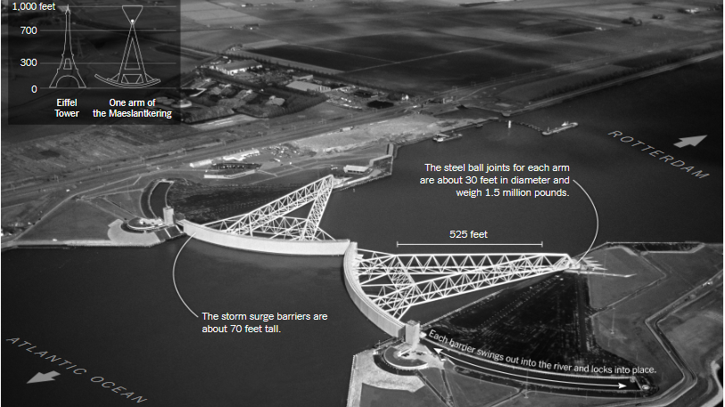
Mitigation: storm surge barrier, Rotterdam (2)
Notes:
https://www.nytimes.com/interactive/2017/06/15/world/europe/climate-change-rotterdam.html

Slide 33
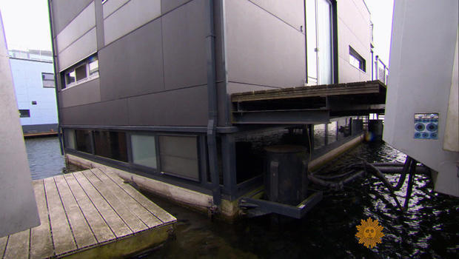
Adaptation: floating house, Amsterdam
Notes:
A floating house in Amsterdam.
https://www.cbsnews.com/news/sea-change-how-the-dutch-confront-the-rise-of-the-oceans/

Slide 34
Proposal to green Phoenix, principally to cool surfaces which
are now heat absorbing tarmac - 30 year framework
Notes:
Of all US cities, only Phoenix is heating up quicker than Dallas, found a 2017 report from the Texas Trees Foundation, which recommended the city plant 250,000 trees to alleviate the sweltering conditions. (Interestingly, despite the increasing heat and warnings that Phoenix won’t be livable for much longer, Metro Phoenix grew by 941,011 people from April 2000 to April 2010, making it one of the fastest growing metro areas in the country.)
More greenery could transform areas of Dallas such as the Southwestern Medical District, one of the hottest areas of the city thanks to its high concentration of roads, concrete and buildings. Illustration: Texas Trees Foundation
https://www.theguardian.com/cities/2019/aug/20/how-us-cities-are-scrambling-to-protect-people-from-extreme-heat#img-7

Slide 35
Mitigation: small scale – surfaces: goo

Slide 36
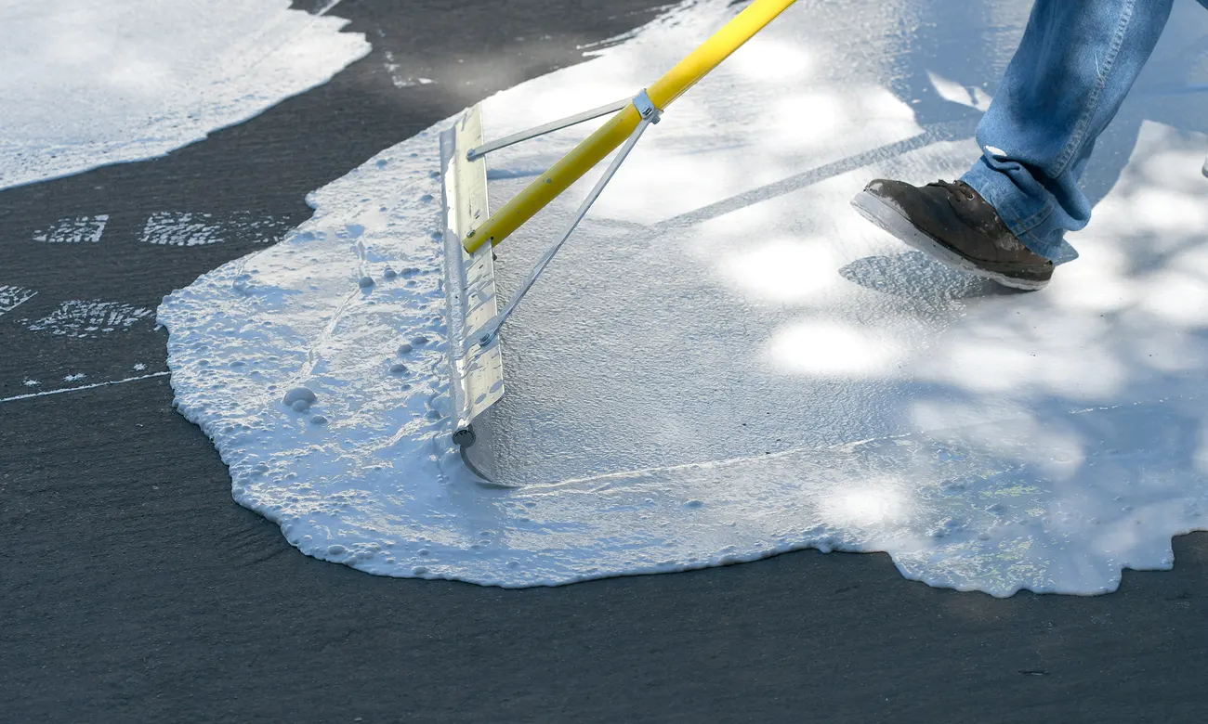
Mitigation: Koolseal goo, water-based, titanium infused Los Angeles
Notes:
Cool Seal or Koolseal, and is a water-basing, titanium infused coating
https://www.theguardian.com/cities/2019/aug/21/cooling-goo-sidewalks-and-other-strange-new-weapons-in-the-war-on-urban-heat

Slide 37
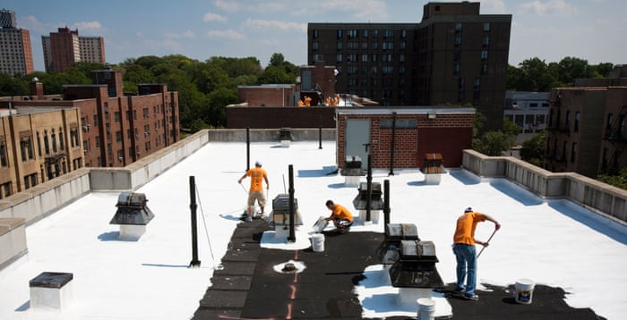
Mitigation: Koolseal goo applied to roof-top, Bronx, NY
Notes:
https://www.theguardian.com/cities/2018/aug/15/what-heat-proof-city-look-like#img-10
Volunteers paint a Bronx, New York, rooftop with a coating that has a high solar reflectivity and infrared emissivity
Photograph: Alamy

Slide 38
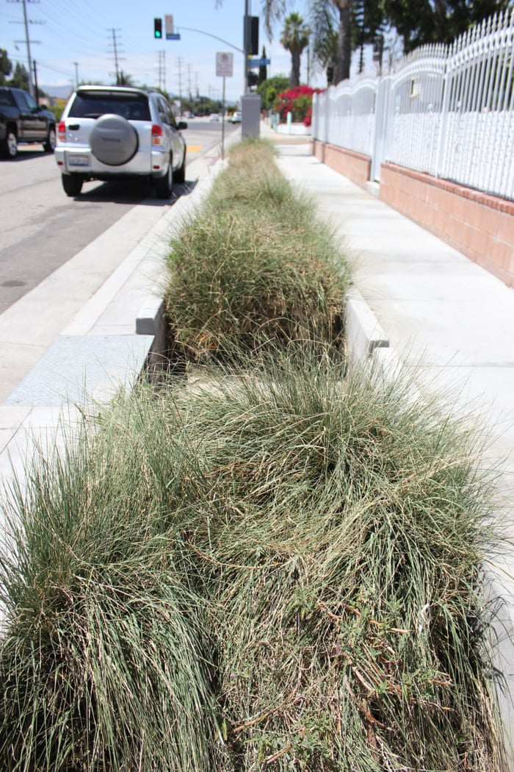
Porous version of Koolseal goo combined with bioswales on a Los Angeles pavement, capturing and filtering rain-water and run-off
Notes:
https://www.theguardian.com/cities/2019/aug/21/cooling-goo-sidewalks-and-other-strange-new-weapons-in-the-war-on-urban-heat
Porous pavement and bioswales capture and filter rainwater and runoff. Photograph: Susie Cagle/The Guardian

Slide 39
Mitigation: vertical re-surfacing

Slide 40
Green terraces in Singapore
Notes:
https://www.theguardian.com/cities/2018/aug/15/what-heat-proof-city-look-like#img-10
Modern skyscraper wall with green terraces, Singapore
Photograph: Vanzyst/Getty Images/iStockphoto
What would heat-proof cities look like?

Slide 41
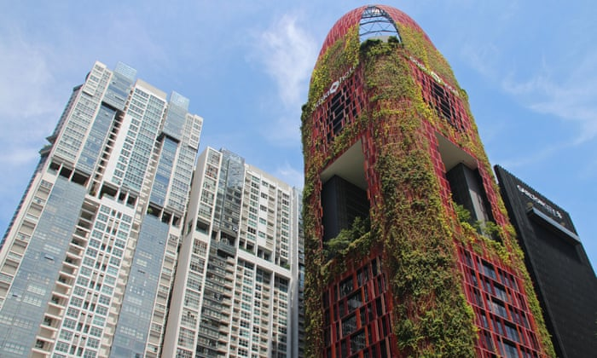
Total green wall in Singapore: Oasis Hotel
Notes:
The Oasia Hotel and Carlton City Hotel in Singapore.
Photograph: Alamy

Slide 42
6. Individual Behaviour

Slide 43
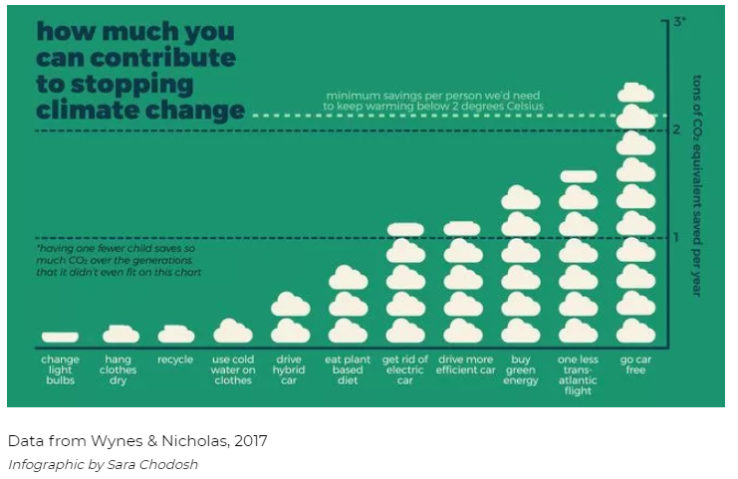

Slide 44
Sustainable diet to keep global temperature below 2C
The way we eat now (average person in the UK, per week) 1.6kg meat and 4.2 litres of milk | Future recommended diet (average person, per week) 500g of meat and 1 litre of milk
3 burgers (450g) | 1 quarter-pound beef burger
6 sausages (450g) | 2 sausages
8 slices of bacon (250g) | 3 rashers of bacon
2 chicken breasts (350g) | 1 chicken breast
3 litres of milk | 1 litre of milk or 100g of cheese
100g of cheese and a helping of cream
4 ham sandwiches (100g)
Source: Food Climate Research Network
Notes:
https://www.theguardian.com/environment/2008/sep/30/food.ethicalliving
The Food Climate Research Network found that measured by production, the UK food sector produces greenhouse gases equivalent to 33m tonnes of carbon. Measured by consumption - including imports - the total rises to 43.3m tonnes. Both figures work out at under one fifth of UK emissions, but they exclude the indirect impacts of actions such as clearing rainforest for cattle and crops, which other studies estimate would add up to 5% to 20% of global emissions.

Slide 45
Weekly ration: 1940
Bacon & Ham 4 oz
Other meat value of 1 shilling and 2 pence (equivalent to 2 chops)
Butter 2 oz
Cheese 2 oz
Margarine 4 oz
Cooking fat 4 oz
Milk 3 pints
Sugar 8 oz
Preserves 1 lb every 2 months
Tea 2 oz
Eggs 1 fresh egg (plus allowance of dried egg)
Sweets 12 oz every 4 weeks
Notes:
After the Second World War began in September 1939 the first commodity to be controlled was petrol. On 8 January 1940 bacon, butter and sugar were rationed. This was followed by successive ration schemes for meat, tea, jam, biscuits, breakfast cereals, cheese, eggs, lard, milk, and canned and dried fruit.
https://www.google.com/imgres?imgurl=https://www.lavenderandlovage.com/wp-content/uploads/2012/11/Rations.jpg&imgrefurl=https://www.lavenderandlovage.com/2012/11/the-wartime-kitchen-living-of-rations-with-ration-book-cooking-day-one.html&h=785&w=800&tbnid=lcNw-8v3z2zgoM:&q=ww2+rationing+amounts&tbnh=160&tbnw=163&usg=AI4_-kRC0oq93lpaanMgThMi-vHu0MW5Mw&vet=12ahUKEwinr83BhLTfAhVH3qQKHbQ4BOwQ9QEwAHoECAYQBg..i&docid=WcINWfAscd3UaM&sa=X&ved=2ahUKEwinr83BhLTfAhVH3qQKHbQ4BOwQ9QEwAHoECAYQBg

